Slide 1

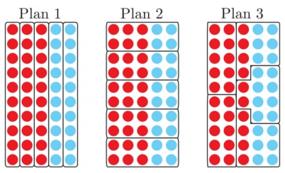
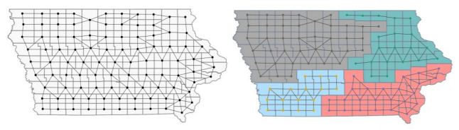
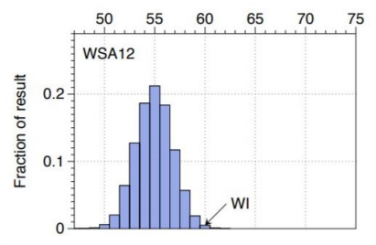
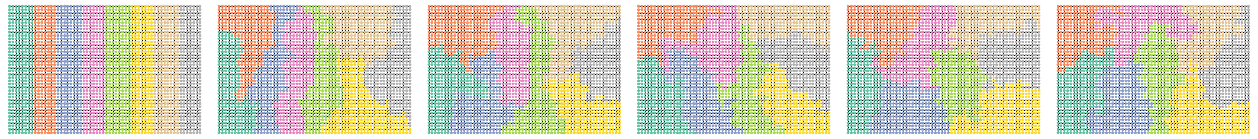
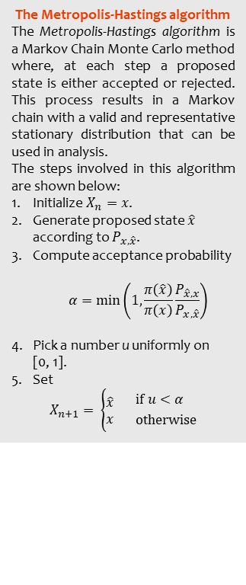
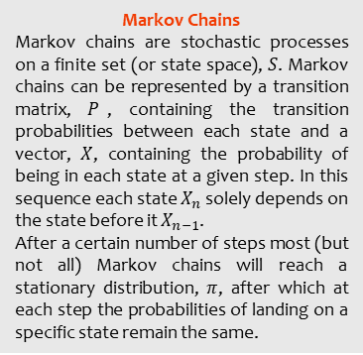
Using MCMC to Measure Voter Unfairness in the Process of Redistricting
Natalie Tripp Foulds
Supervised by
Dr Graeme Wilkin
Gerrymandering
Gerrymandering occurs when the political district lines are deliberately drawn in such a way as to favour a certain party. A simple example of this can be seen in figure 1, in which despite the same number of votes in each plan, plan 1 and 2 would be won by the red party whilst plan 3 would be won by blue.
To stop this from happening mathematicians are trying to find ways of measuring how fair a particular district plan is (and hence deciding if it should be considered a gerrymander). One of these ways is by using Markov Chain Monte Carlo (MCMC) methods.
Markov Chain Monte Carlo (MCMC) methods
A solution to the problem of detecting gerrymandering is to simply take all the possible redistricting maps and hence measure which ones are the least common (the most altered). However, it would take an immense amount of time to find every possible map [4]. MCMC is a way of measuring gerrymandering by just collecting a selection of all the possible ways a specific area can be partitioned to see how accurately each map represents the overall demographic vote of that area. The maps collected need to be valid redistricting maps and representative of the overall possibilities, hence the following techniques are combined.
Figure 1: A simple example of gerrymandering [1]
Markov Chains
Markov chains are stochastic processes on a finite set (or state space), $S$. Markov chains can be represented by a transition matrix, $P$, containing the transition probabilities between each state and a vector, $X$, containing the probability of being in each state at a given step. In this sequence each state $X_{n}$ solely depends on the state before it $X_{n−1}$.
After a certain number of steps most (but not all) Markov chains will reach a stationary distribution, $π$, after which at each step the probabilities of landing on a specific state remain the same.
The Metropolis-Hastings algorithm
The Metropolis-Hastings algorithm is a Markov Chain Monte Carlo method where, at each step a proposed state is either accepted or rejected. This process results in a Markov chain with a valid and representative stationary distribution that can be used in analysis.
The steps involved in this algorithm are shown below:
Initialize $X_{n}=x$.
Generate proposed state $\hat{x}$ according to $P_{x,\hat{x}}$.
Compute acceptance probability
$$α=min\left(1, \frac{π\left(\hat{x}\right)}{π\left(x\right)}\frac{P_{\hat{x},x}}{P_{x,\hat{x}}}\right)$$
Pick a number u uniformly on [0, 1].
Set
$$X_{n+1}= \left\{\begin{aligned}\hat{x} \\ x \end{aligned} {if u<α \atop otherwise}\right.$$
Figure 2: A dual graph of the U.S. state of Iowa [2]
Figure 3: Outlier analysis plot of the 2012 elections in Wisconsin [3]
Steps for redistricting
An initial partition is created on a dual graph of the area (see figure 2).
Markov chains are run on the initial plan (in the form of a random walk).
Node by node the districts are altered.
The Metropolis-Hastings algorithm is used to check whether the proposed plan at each step is a valid redistricting plan.
The algorithm is usually halted once enough steps have been completed for the chain to reach a stationary distribution.
An ensemble of valid redistricting maps is created from the samples.
Outlier analysis is performed on the ensemble. If the redistricting map appears to be an outlier, it could be a case of gerrymandering (see figure 3).
Monte Carlo Simulations
The goal of Monte Carlo simulations is to approximate an expected value from an unknown distribution. This is done by sampling from random data points in the distribution and finding the expected value of each point one by one, through a simulation of the scenario.
Conclusion
This field is constantly progressing as mathematicians are continuously attempting to find faster and more reliable algorithms for handling the issues surrounding redistricting. Investigating the topic and performing MCMC methods on a simple grid (see figure 4) showed this technique to be a very efficient and easily applicable way of measuring voter unfairness.
Figure 4: The Metropolis-Hastings algorithm implemented on a 40x60 grid over 250,000 steps
References: [1] Kristopher Tapp, Measuring political gerrymandering, The American Mathematical Monthly 126 (2019), no. 7, 593–609. [2] Daryl De Ford, Moon Duchin, and Justin Solomon, Recombination: A family of Markov chains for redistricting (2020). [3] Gregory Herschlag, Robert Ravier, and Jonathan C Mattingly, Evaluating partisan gerrymandering in Wisconsin, arXiv preprint arXiv:1709.01596 (2017). [4] Moon Duchin, Geometry v. Gerrymandering, The Best Writing on Mathematics 2019, (2019).

